Slide 1
Correcting Eye Tracking Data Using Machine Learning
Luhang Sun, Deka Popov, Bret Miller, Sidney Liu

Slide 2
Background
Existing research documents ten major algorithms and evaluates them using simulated and natural eye-tracking data
Suggests that method based on dynamic time warping is a good option
Some algorithms are better suited than others to particular types of drift phenomena and reading behavior
Carr, J.W., Pescuma, V.N., Furlan, M. et al. Algorithms for the automated correction of vertical drift in eye-tracking data. Behav Res 54, 287–310 (2022). https://doi.org/10.3758/s13428-021-01554-0

Slide 3
Motivation
Reading Eye Tracking Data requires correction following trials
Maintaining proper camera calibration
The most reliable method of correction: manual correction
Time intensive and not feasible for large datasets
Synthetic data and real world data are drastically different
Current automated correction options are not reliable and accurate with real data
Unreliable data means unreliable research

Slide 4
Research Question
Does utilizing a classification layer between data collection and correction increase the accuracy of the corrections that are performed on reading eye tracking data?

Slide 5
Experiment Design
Create a synthetic dataset that simulates different forms of drift phenomena at different levels
Pick the best-performing algorithm for each type of error by correcting synthetic data with different levels of drift phenomena
Run this synthetic dataset through a Neural Network implementation to classify the most prominent type of error in the trial, then correct with appropriate algorithm
Compare the outcomes of the classification network corrections and non-classification network corrections
Manually correct a “Golden Dataset” of real world data that will be the ground truth
Use Golden Dataset to train and use in Neural Network
Compare accuracies of Golden Dataset without classification before and with classification before

Slide 6
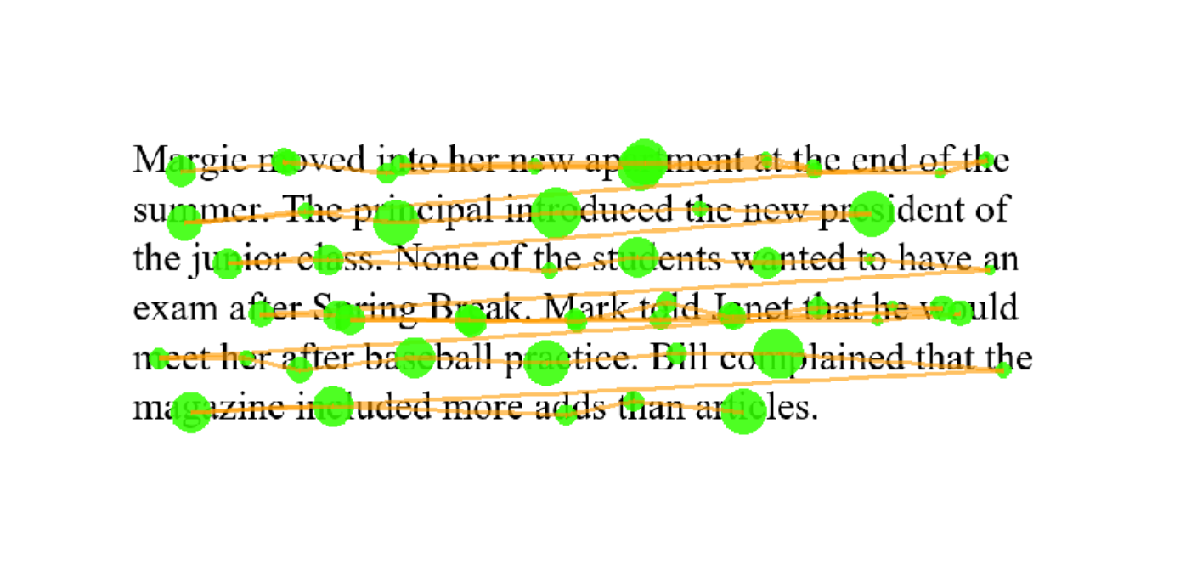
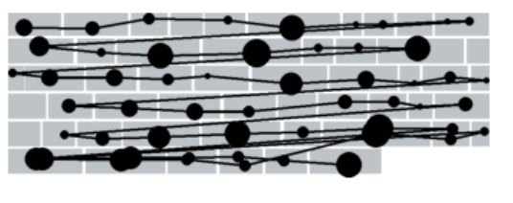
Setting Up for Neural Networks
“Trial as images” -> image classification problem
Four major errors: noise, droop, shift, and offset
Network comparison
1 Dense layer
1 Convolutional layer + 1 Dense layer
Transfer learning and fine-tuning with MobileNet
Input generalization

Slide 7
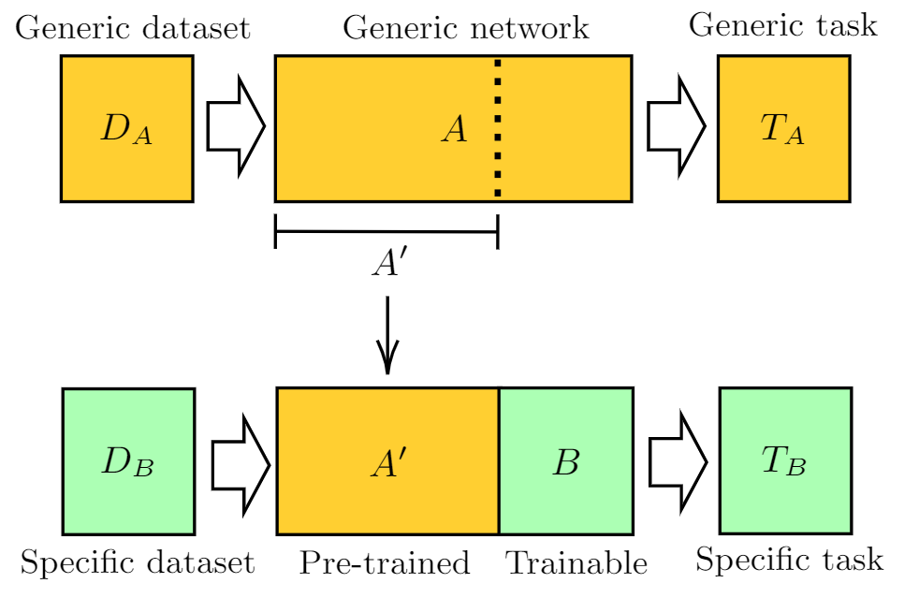
Transfer Learning

Slide 8
Synthetic Dataset
error_type = [“noise”, “shift”, “droop”, “offset”, “no error”]
FOR each error_type:
FOR error_magnitude = 1 to 10
FOR trial = 1 to 100:
Generate fixations with random regression and skipping
Add an error phonomena with specified magnitude to fixations
Notes:
Deka

Slide 9
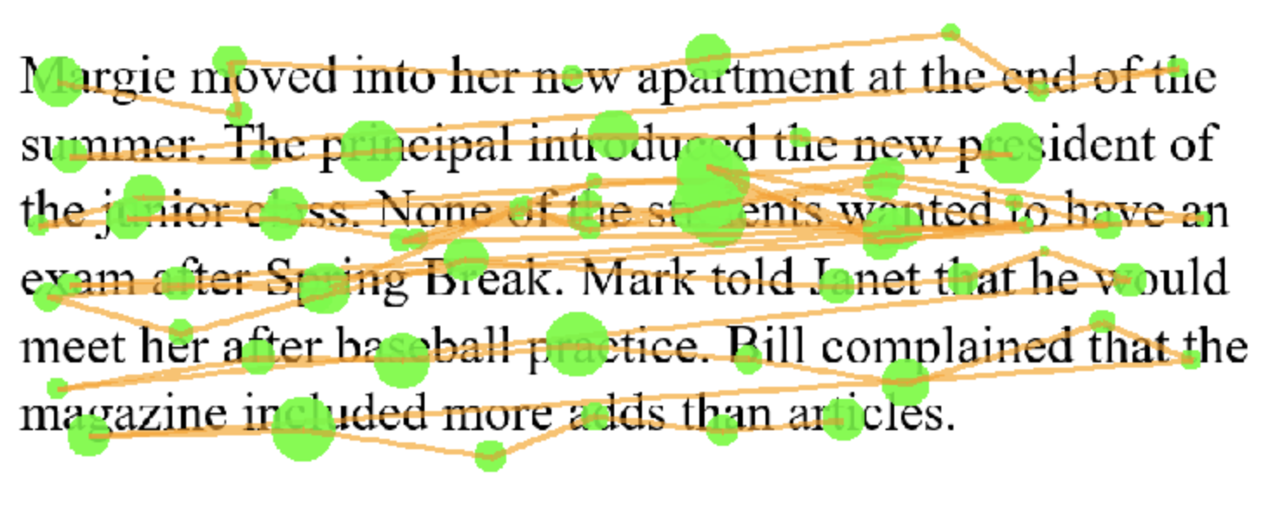
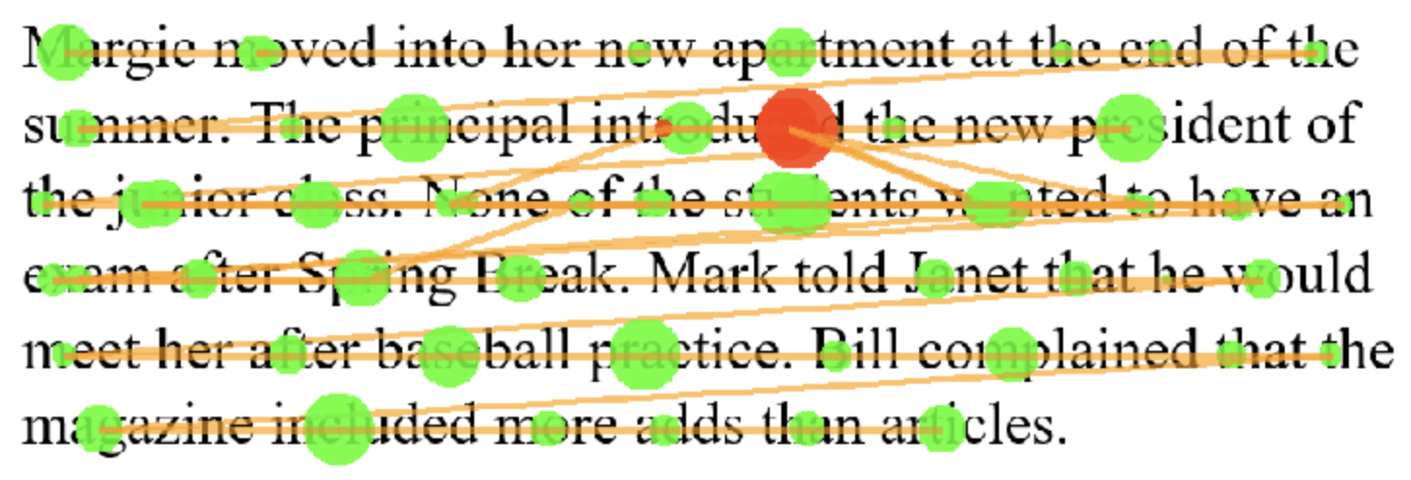
Synthetic Data Correction: Noise (“chain” algorithm)
Uncorrected
Corrected

Slide 10
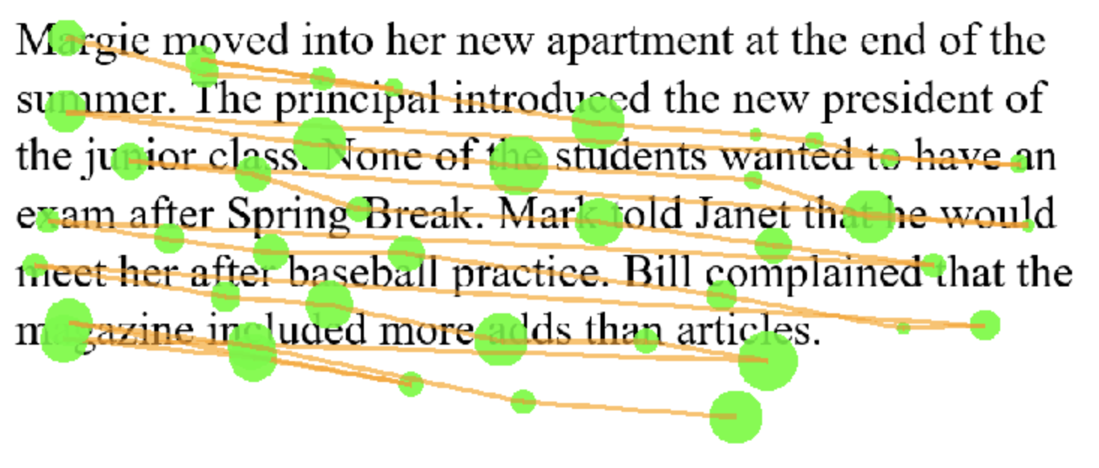
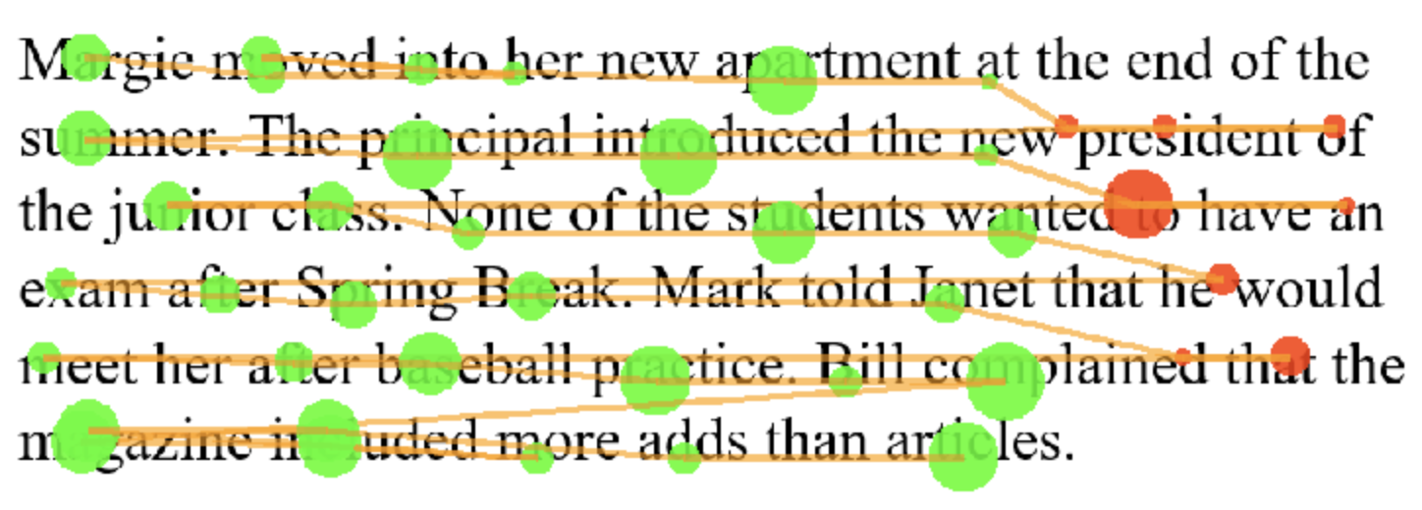
Synthetic Data Correction: Droop (“regress” algorithm)
Uncorrected
Corrected

Slide 11
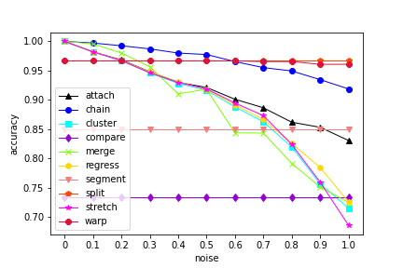
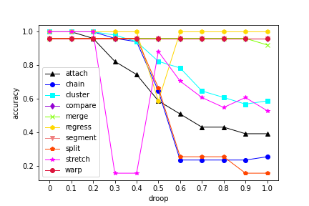
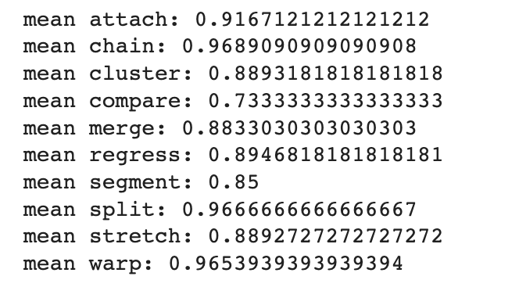
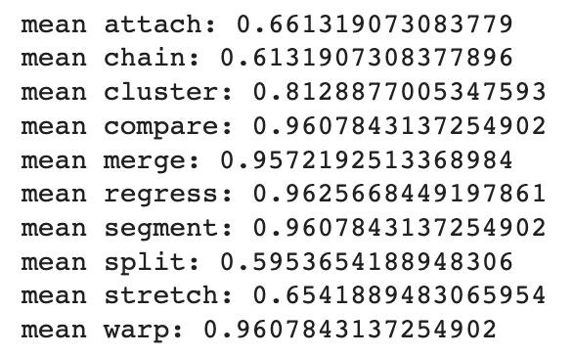
Algorithm Accuracy on Synthetic Data (noise, droop)
Notes:
Deka

Slide 12
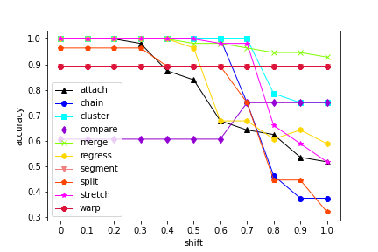
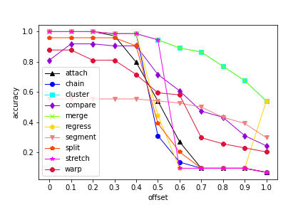
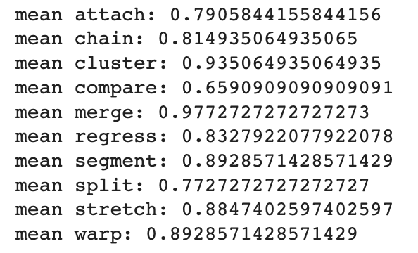
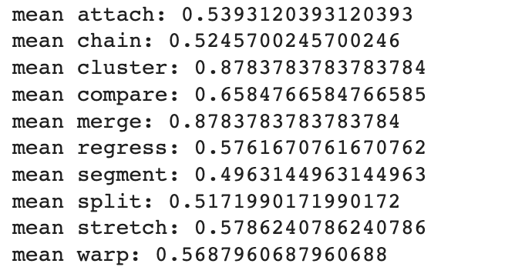
Algorithm Accuracy on Synthetic Data (shift, offset)

Slide 13
Golden Set Generation
Fix8 program for manual correction
Golden Set consists of Json files of manually corrected data
Each corresponds to a uncorrected data file
The Golden Set contains 15 manually corrected trials
Provided strong insight into the reading behaviors of individuals
Influenced how we understood the research we were doing
Notes:
Bret

Slide 14
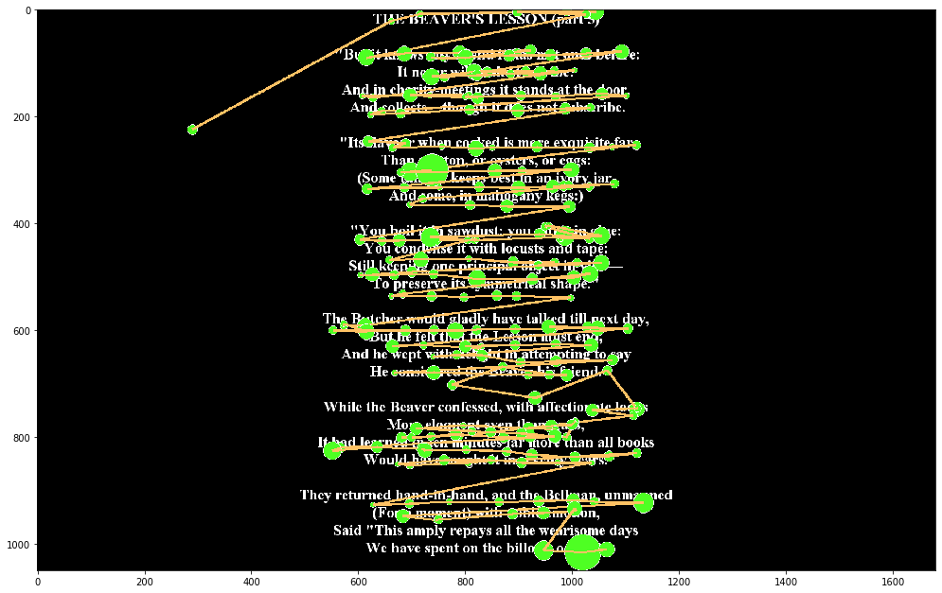
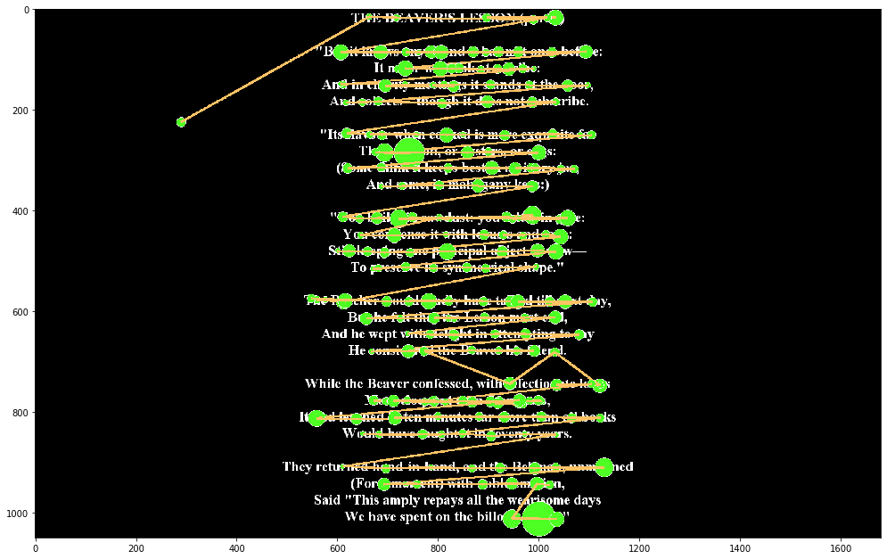
Uncorrected
Corrected

Slide 15
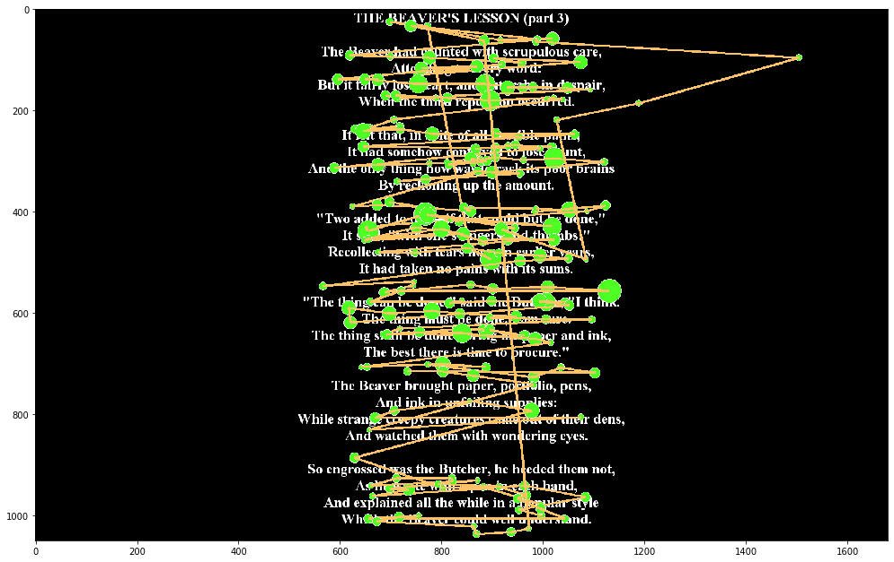
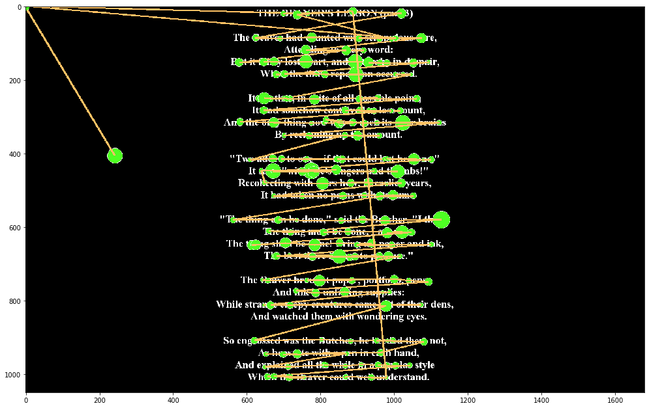
Uncorrected
Corrected

Slide 16
Correction Accuracy on GazeBase
8 algorithms developed by other researchers
Ran each of the 15 Golden Set trials through each algorithm
Carr’s paper and the issues with real world data and automated algorithms
After tuning the algorithms, we received usable accuracy results
We compared the algorithms against each other, across trials
This would be the comparison point for if adding classification would increase accuracy
Notes:
Bret

Slide 17
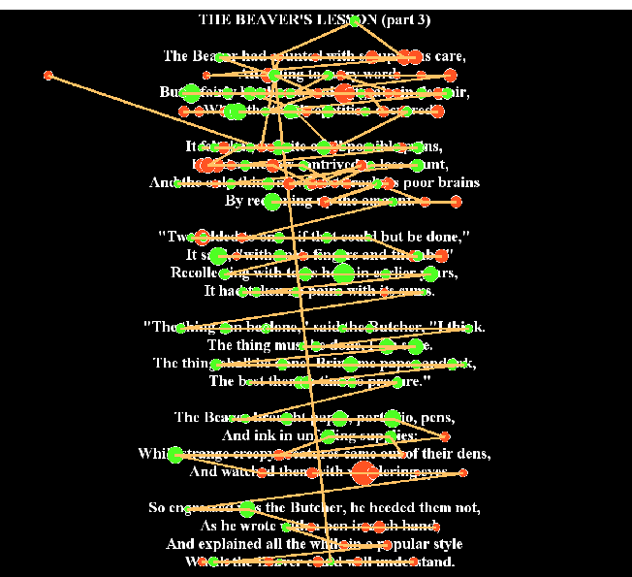
“Regress” Algorithms on GazeBase
Correction algorithms are generally able to correct droop, offset and short-distance regressions
They are not good at correcting multi-line regressions and skipping

Slide 18
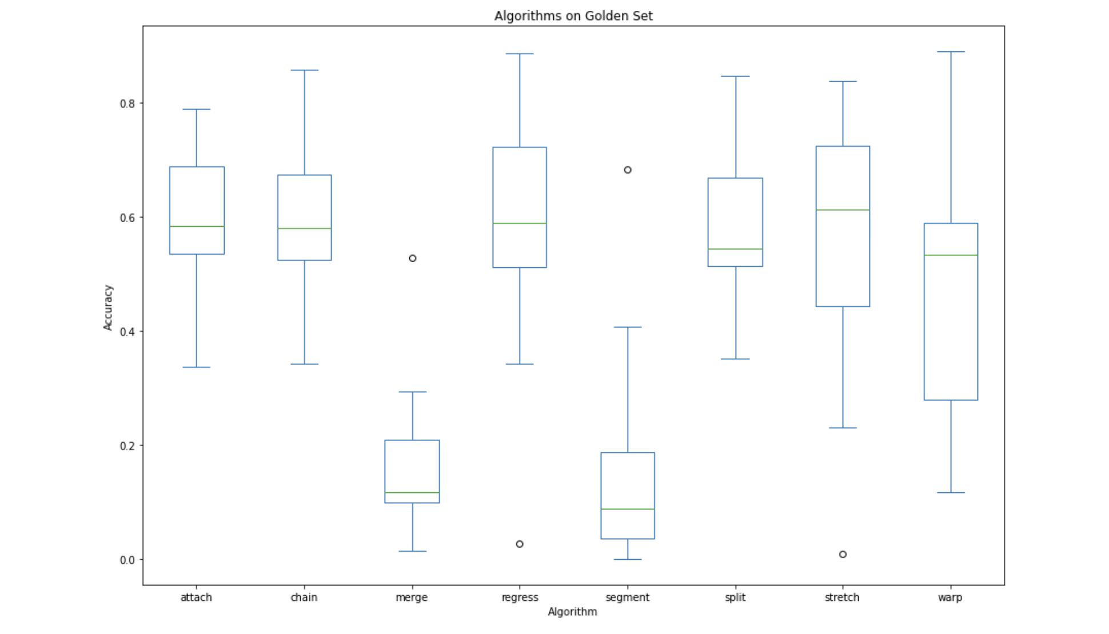
Correction Accuracy

Slide 19
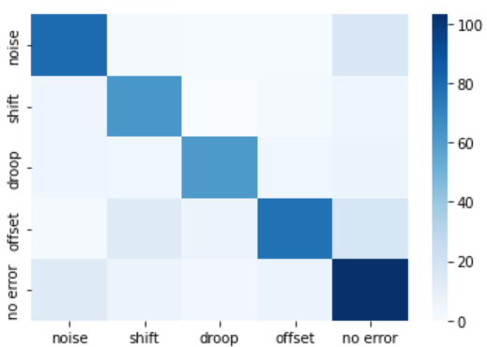
NN Classifier Accuracy
Test set was generated by random selection of error type, regression/skipping probability, and scale of error
Epochs = 30; batch_size = 30
~97% training, ~81% testing accuracy
Notes:
Luhang

Slide 20
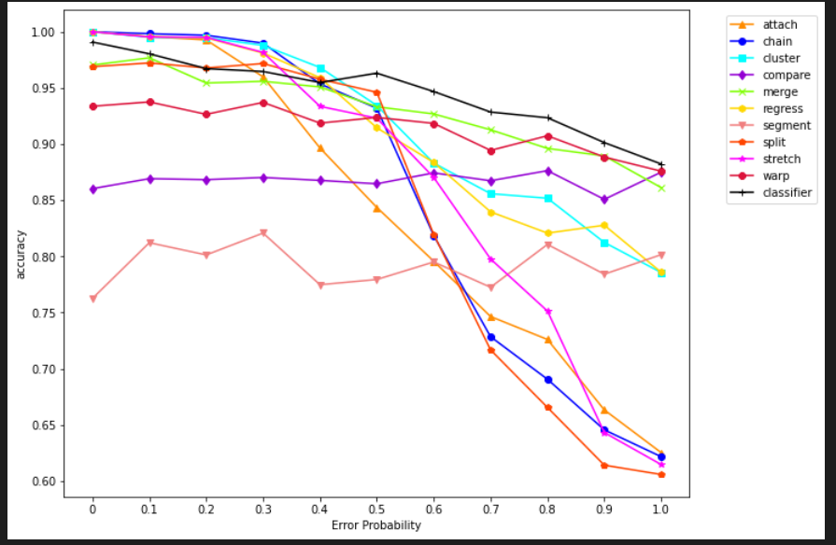
Did classification help correction on Synthetic data?
The average of all four types of errors repeated for 30 times (120 samples) at each error magnitude
Comparatively low accuracy of the classifier model at low error magnitude due to low prediction accuracy when error magnitudes are small
Low probabilities of errors confuse the classifier to predict as “no error” -> no correction
Noise -> split
Droop -> regress
Shift -> merge
Offset -> merge/cluster
Notes:
Summary of which algorithm to select

Slide 21
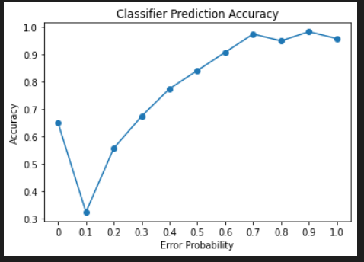
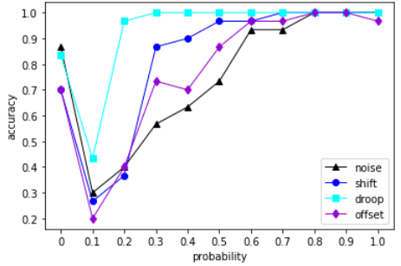
Classifier’s confusion at low error probability
At 0 error magnitude, the correct label is “no error”
The classifier tends to predict trials with error magnitude < 0.4 as “no-error”

Slide 22
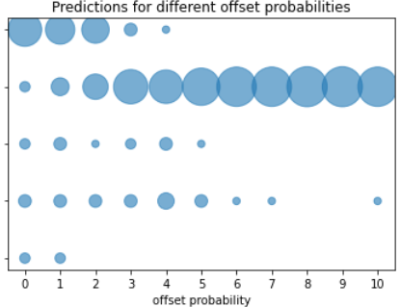
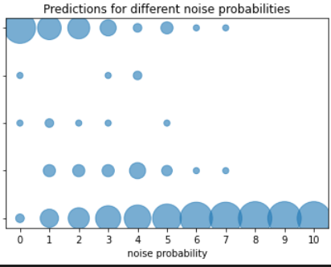
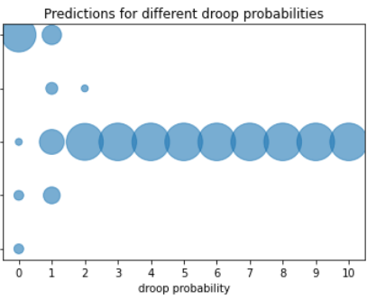
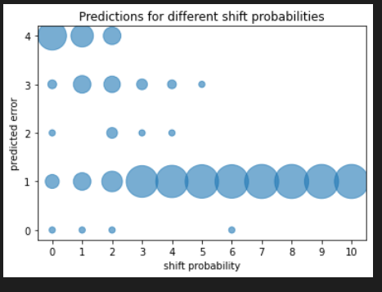
No error
Offset
Droop
Predicted Error
Shift
Noise
No error
Offset
Predicted Error
Droop
Shift
Noise

Slide 23
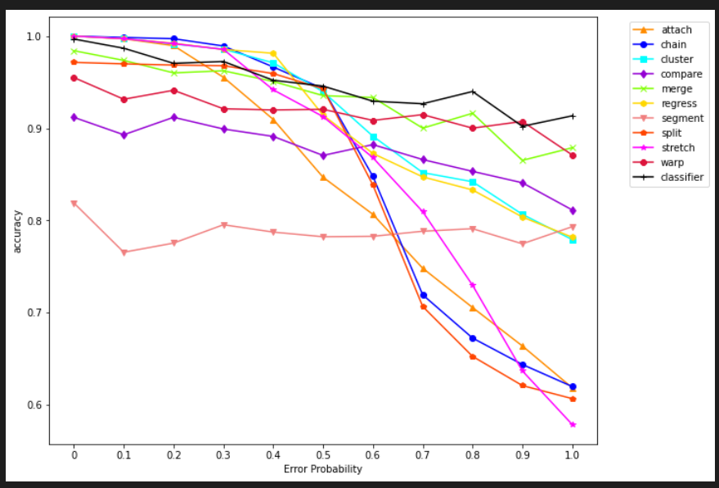
“Hacking” for a better accuracy
Use “chain” when predicted as “no error”
Notes:
Although it seems like a hack for better accuracy if we eventually determine that this is truely the problem here this could be a reasonable solution

Slide 24
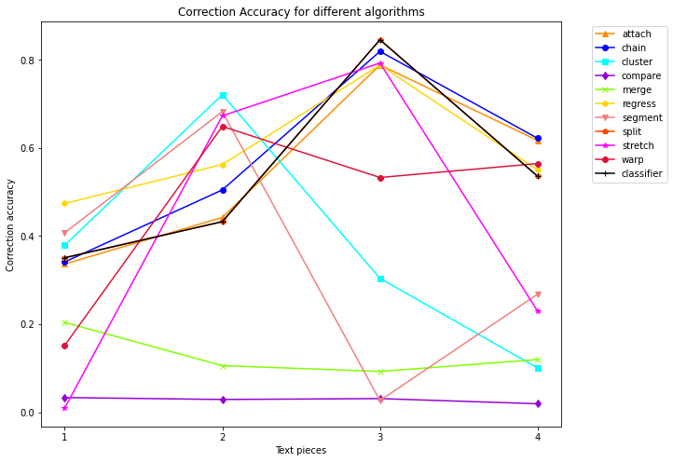
Classifier with real data
“Noise is the most prominent error in every trial”
The accuracy of using classifier strictly follows “split”
There is not a single algorithm that performs the best among every trial due to the complexity of real-data

Slide 25
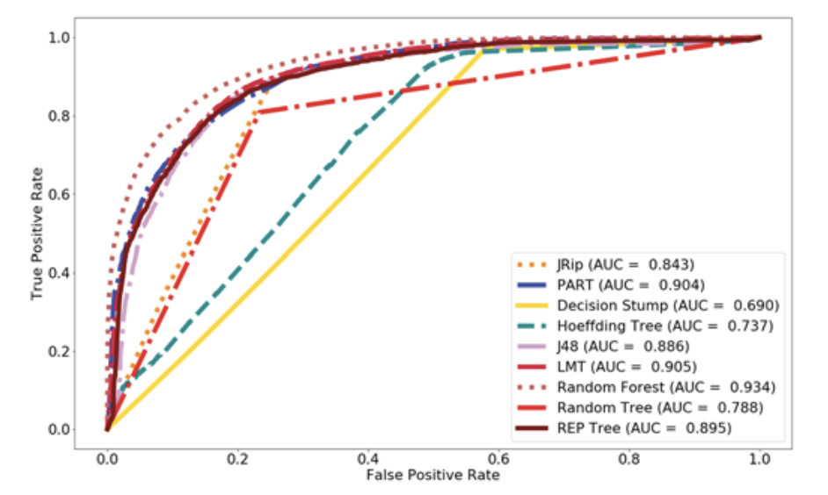
Rule-Based Approach
Existing literature is very limited.
Peripheral research using decision trees and rule-based components cite up to 84% accuracy.
Serves as a comparison to NN-based approach.
Fuhl, W., Castner, N., & Kasneci, E. (2018, October). Rule-based learning for eye movement type detection. In Proceedings of the Workshop on Modeling Cognitive Processes from Multimodal Data (pp. 1-6).
De Silva, S., Dayarathna, S., Ariyarathne, G., Meedeniya, D., Jayarathna, S., Michalek, A. M., & Jayawardena, G. (2019, July). A rule-based system for ADHD identification using eye movement data. In 2019 Moratuwa Engineering Research Conference (MERCon) (pp. 538-543). IEEE.

Slide 26
Method
Basic implementation. No rule extraction was used.
Chooses class based on the most prominent error type, i.e the most number of times a rule for a particular error type has been triggered.

Slide 27
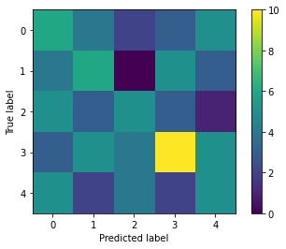
Results
RID | word_length < 4 | x_offset | y_offset | angle < 180 | angle > 180
0 no error | no | no | no | no | no
1 droop | no | no | yes | no | yes
2 offset | no | yes | yes | no | yes
3 noise | no | yes | yes | yes | yes
4 shift | no | yes | yes | yes | yes

Slide 28
Future Work
Rule-based time series algorithms
Rule extraction using decision tree, PRISM, etc
Real-time correction algorithms
Machine learning model to look at how people correct these trials
Other Neural Network models

Slide 29
Thank you! Questions?

